Slide 1

Helping Hands

Slide 2
Problem Statement
Our main mission is "providing an immediate response to basic human needs." Essential items such as food (that last up to several days), clothing are given to the needy.
We believe that food should never go waste and the food has to reach as soon as possible based on the proximity of the consumers.
Many people are deprived of warm clothes and its a big issue during the winters.

Slide 3
APPROACH
Java Netbeans as a platform and Swings Framework was used.
We firstly created Networks and Enterprises were added to this.
3 Enterprises were added to each Network.
3 Organizations were added to each Enterprise.
In every Organization we have three roles namely- Admin, Consumer and Supplier.
We are implementing an Eco System model here and the work flow is based entirely on this model.
Mail API was implemented to update and communicate with consumer.

Slide 4
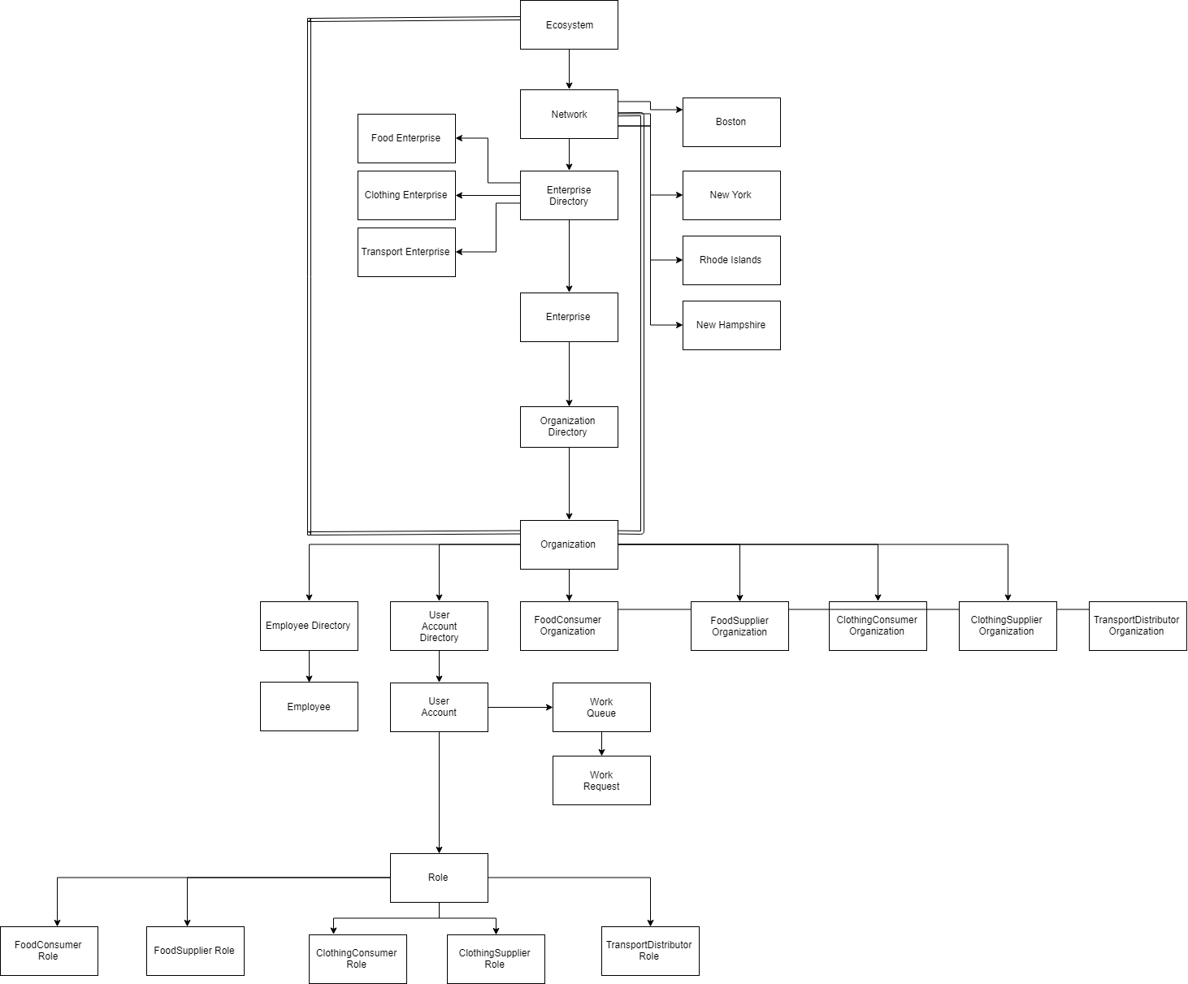
Object Model
Done!!!!!!!!!!!!!!

Slide 5
Use Cases or Functionalities
Entities :
Food Admin, Clothes Admin, Transport Admin
Food Supplier, Food Consumer
Clothing Supplier , Clothing Consumer
Transport Distributor
Use cases:
The Admin can delegate work to the Supplier and Checks if Consumer is authentic
A consumer can place a request based on need and this will go to Supplier who can view it and immediately provide him with the necessities.
Food Suppliers- Can be restaurants, Caterers, Party Halls, Home.
Food Consumers-Can be orphanages, distressed people etc.

Slide 6
Clothes Suppliers- Can be retail shops like Zara, any individual who is ready to give clothes which is in good condition.
Clothes Consumers- Any one in need of warm clothes
Transport Distributors- FedEx, DHL, USPS

Slide 7
Functionality
Every Enterprise has an admin and through them we can create Employees of a particular organization and assign a Role to them.
A consumer can place a request here and all the suppliers can see this request.
Any supplier in close proximity to the consumer or based on his feasibility can pick up the request, process it and communicate accordingly.
This is given to an other Enterprise- the Transport Enterprise and the Transport ensures that food/clothing reaches the Consumer.
Both the supplier and Consumer receive a notification of this real-time Event using Mail API.

Slide 8
Food items are distributed on priority at which the Consumers need it and if the number of suppliers and consumers match as closely as possible.
Clothing items are also distributed to the needy.

Slide 9
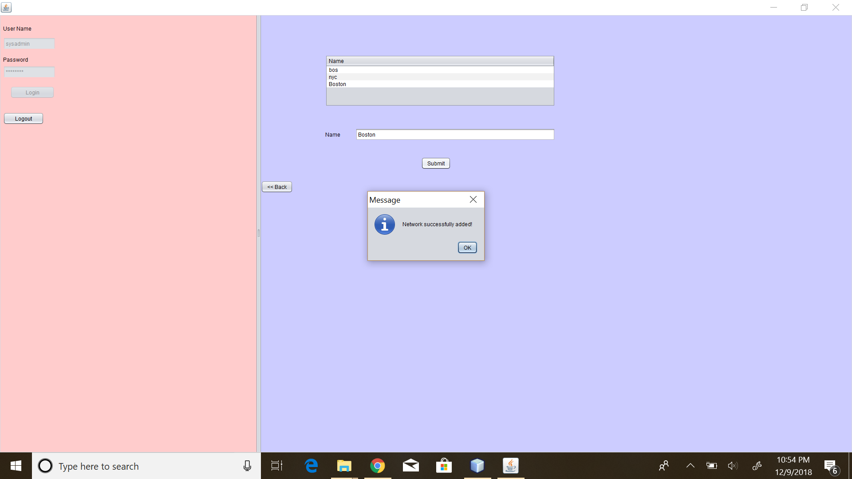
Screenshots

Slide 10
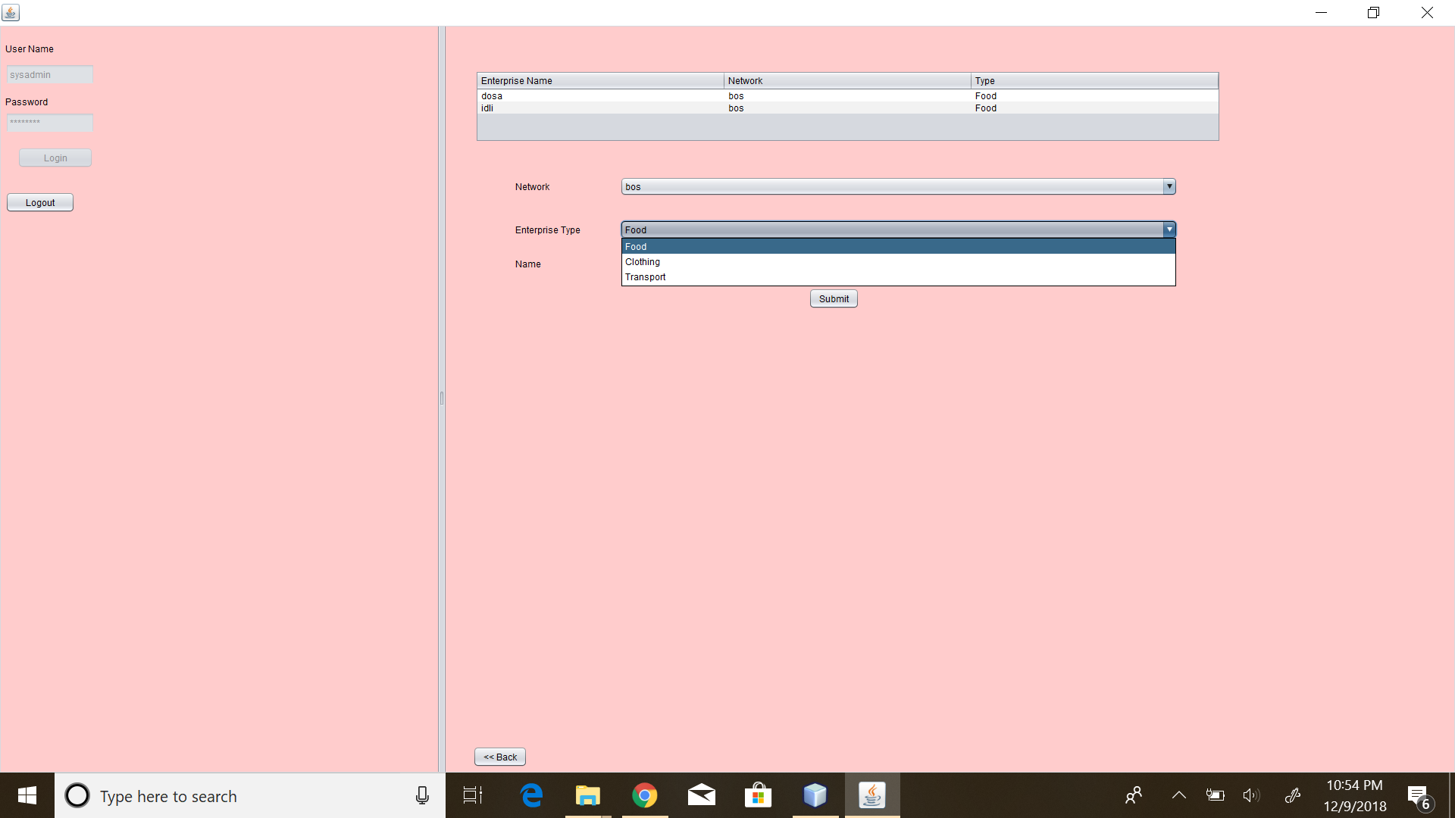
Screenshots

Slide 11
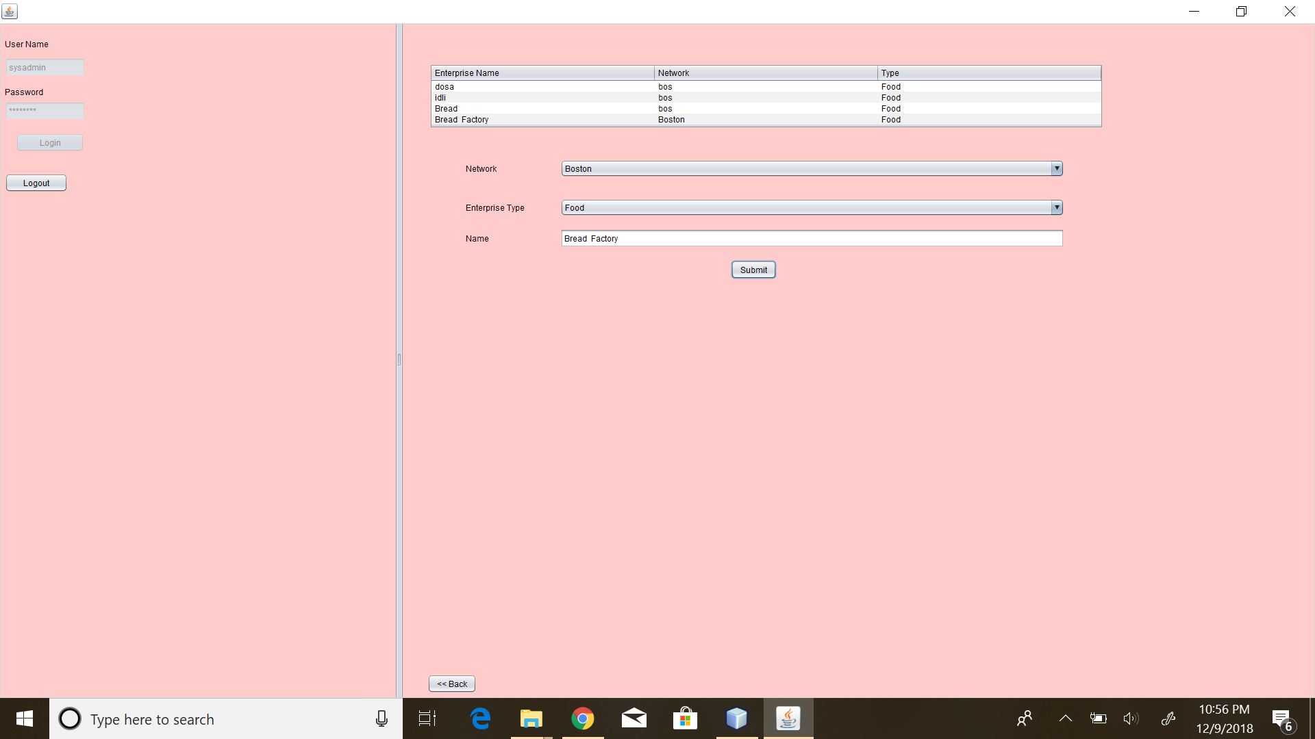
Screenshots

Slide 12
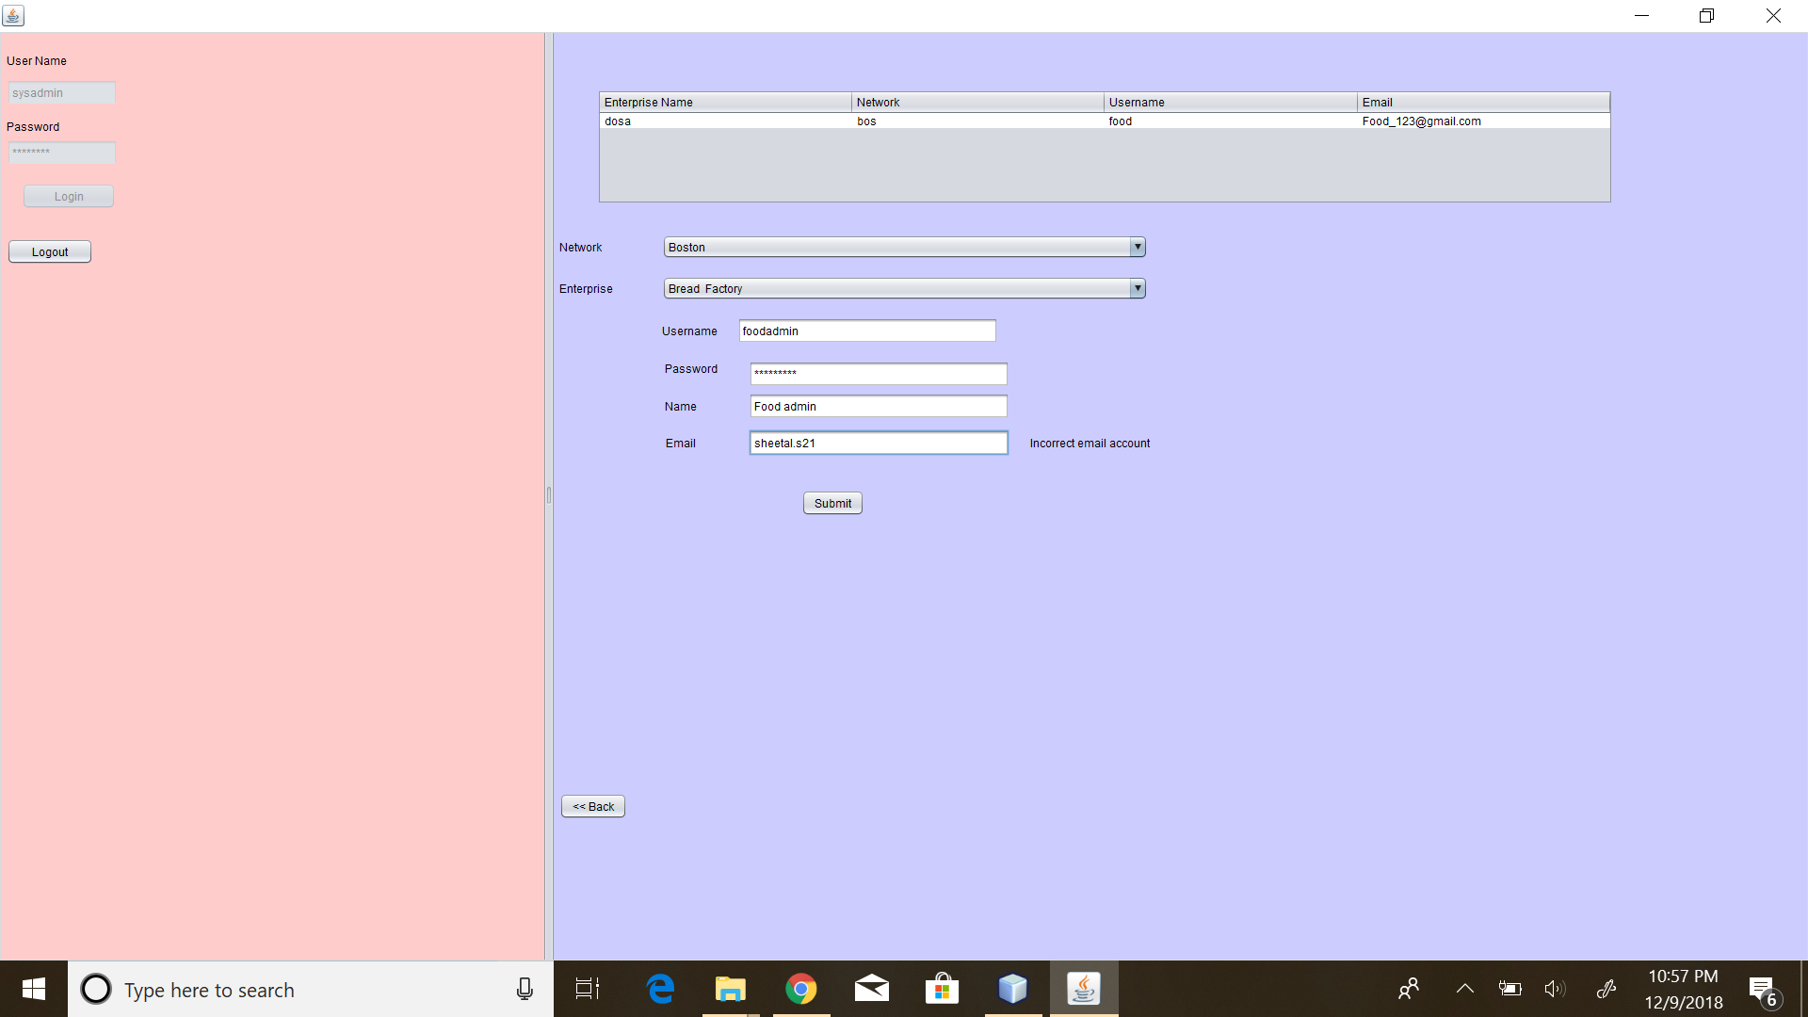
Screenshots

Slide 13
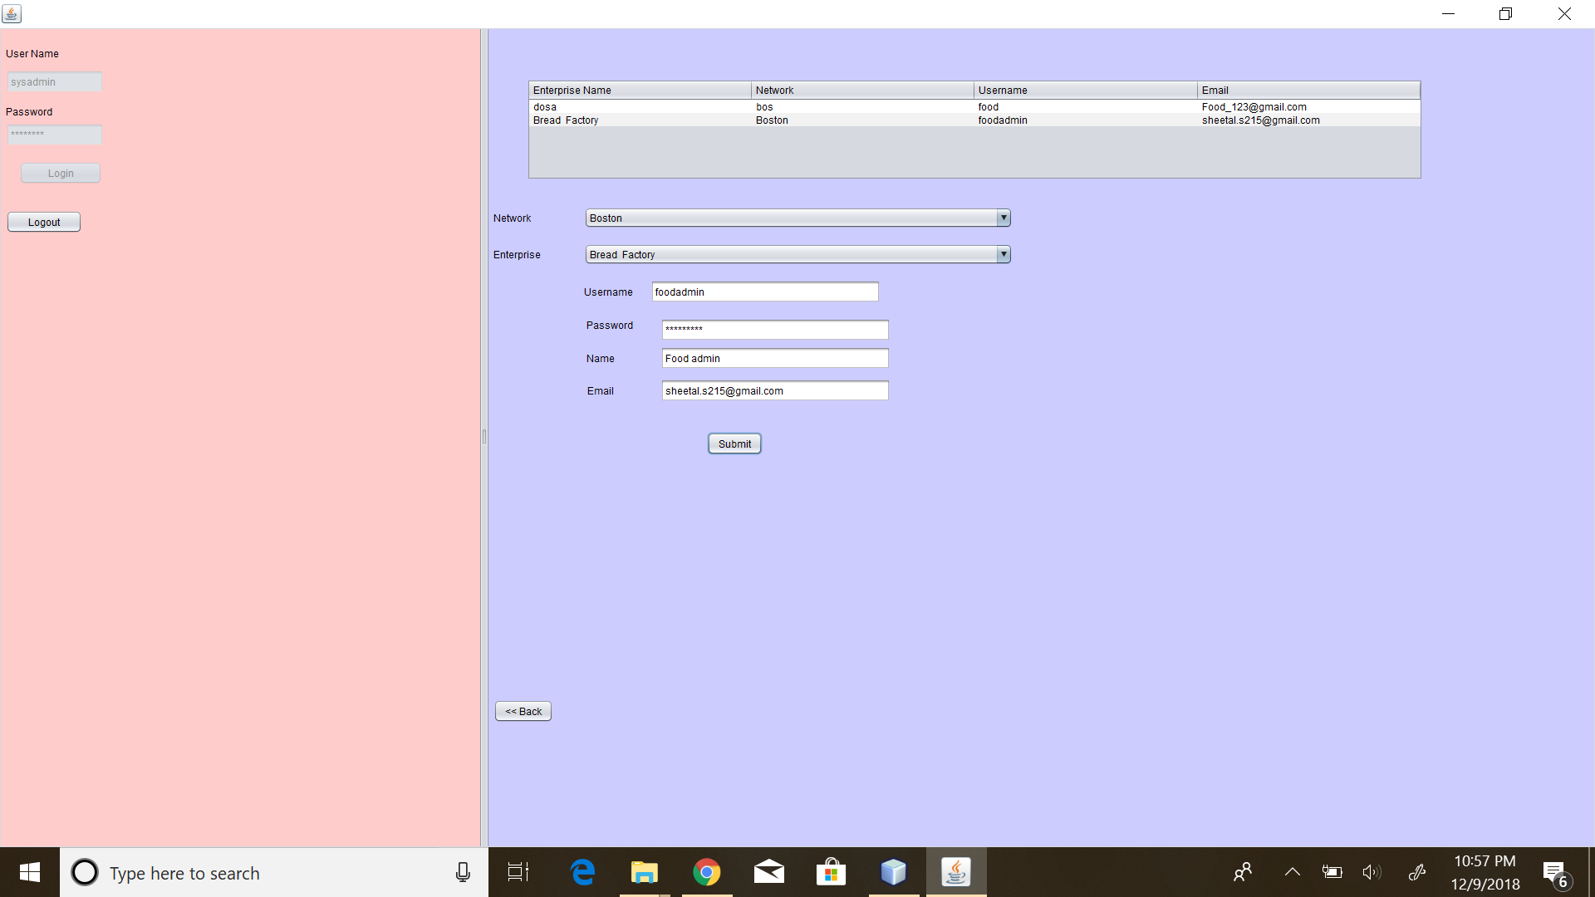
Screenshots

Slide 14
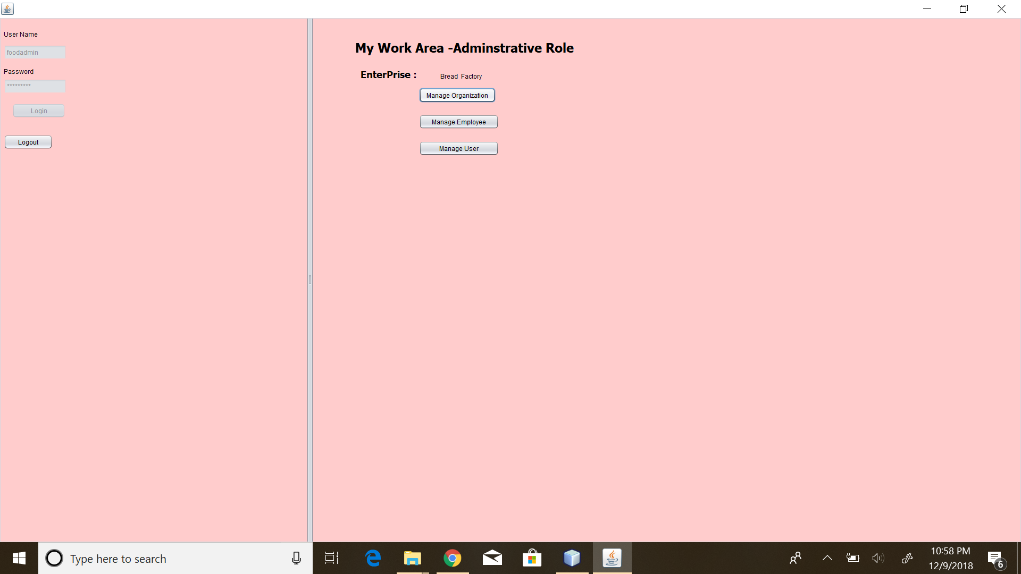
Screenshots

Slide 15
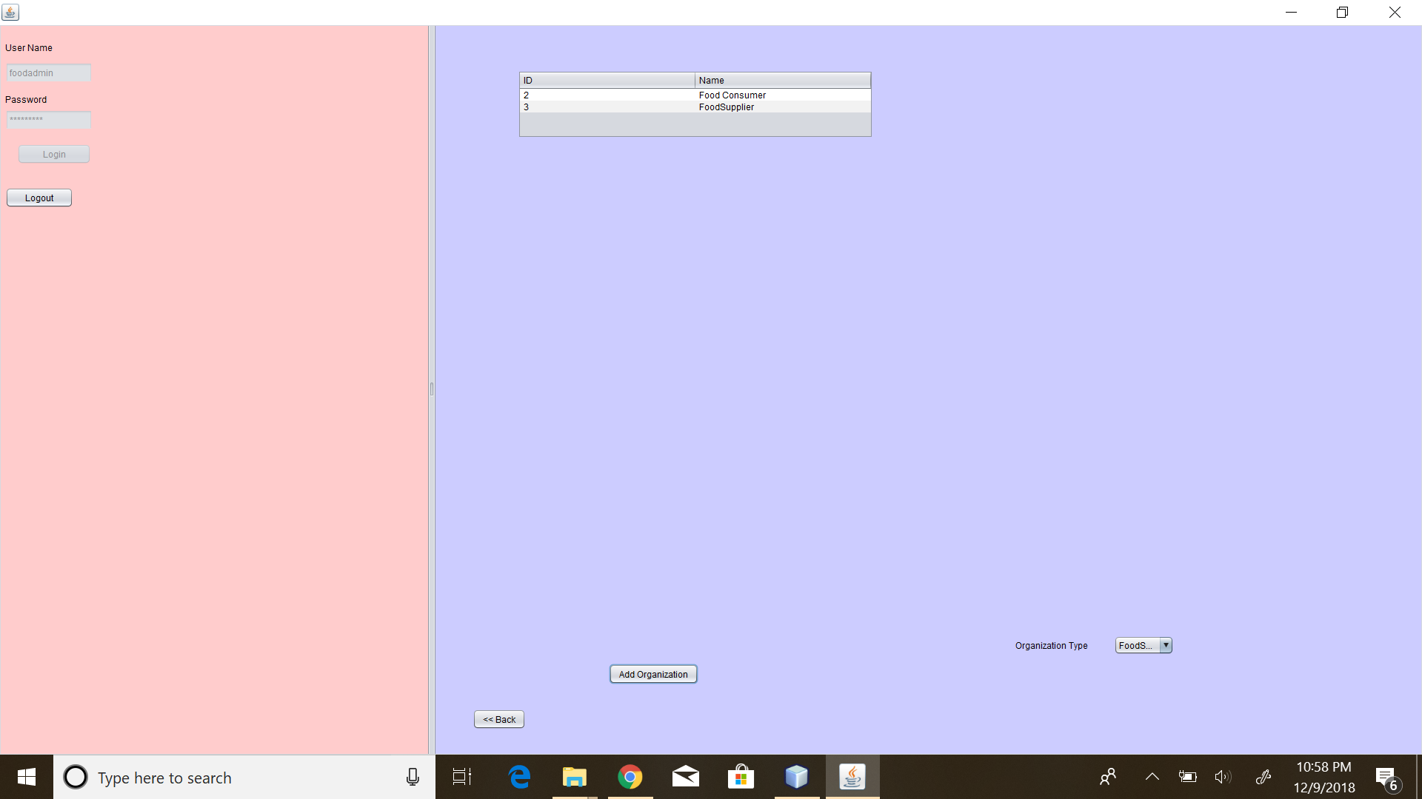

Slide 16
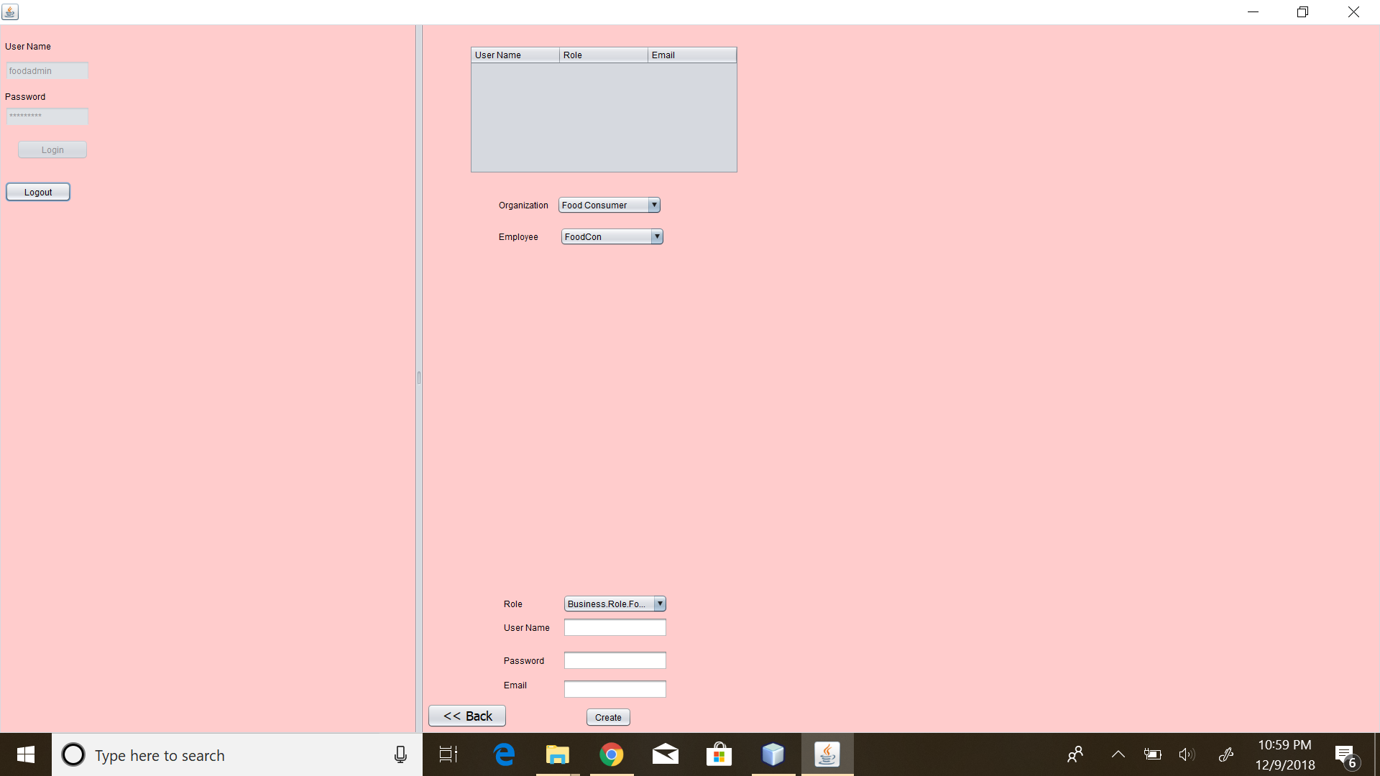

Slide 17


Slide 18
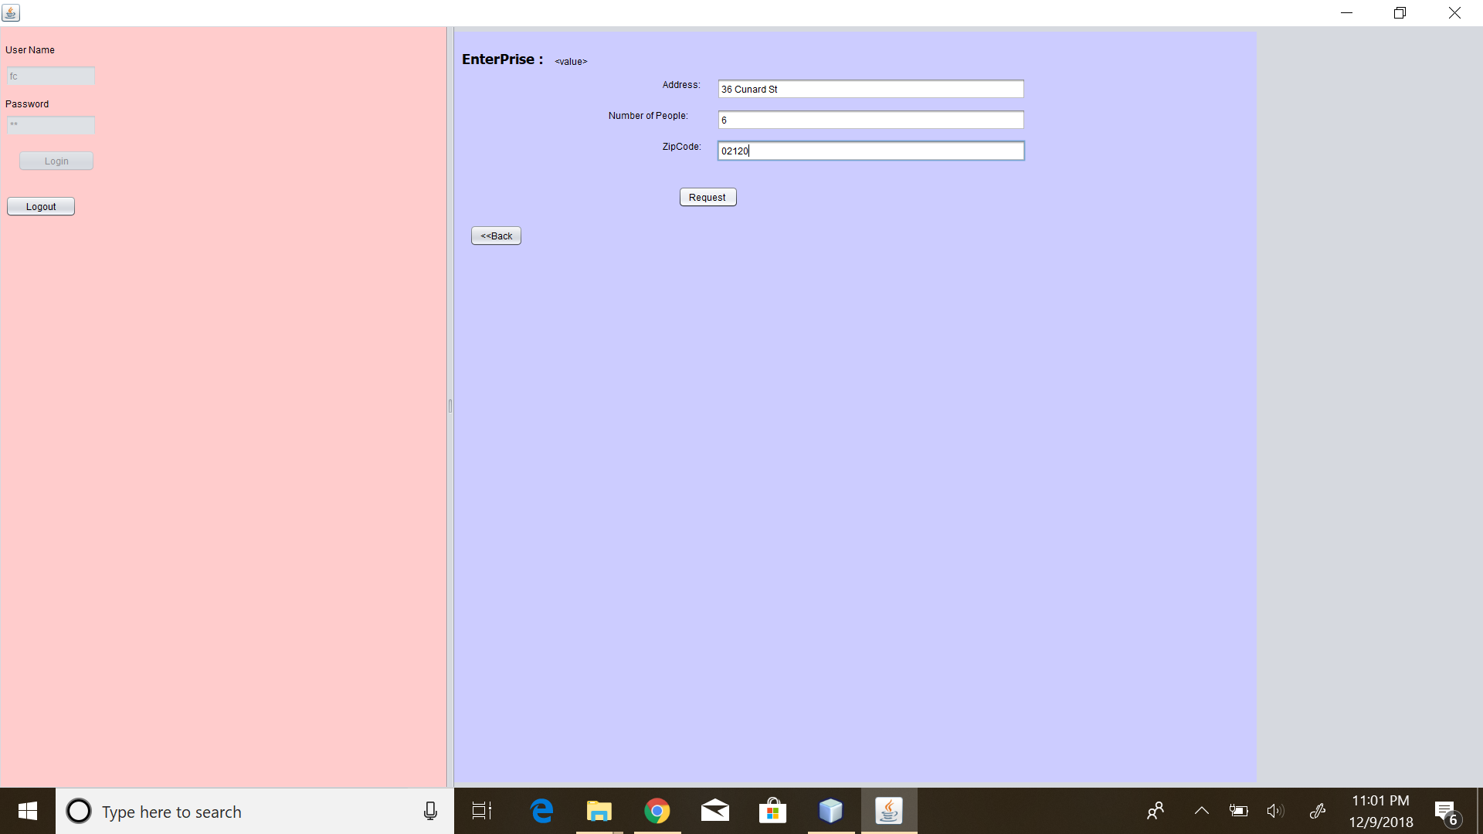

Slide 19
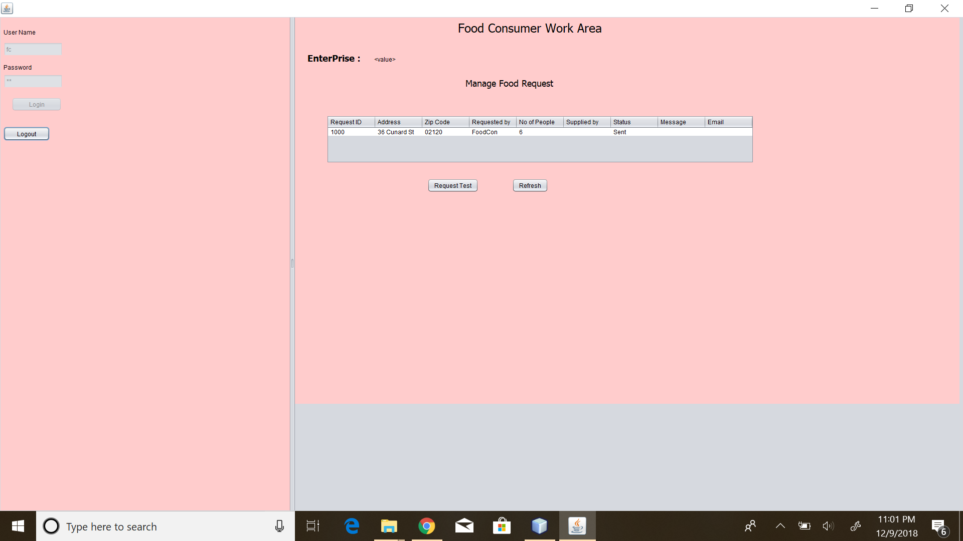

Slide 20
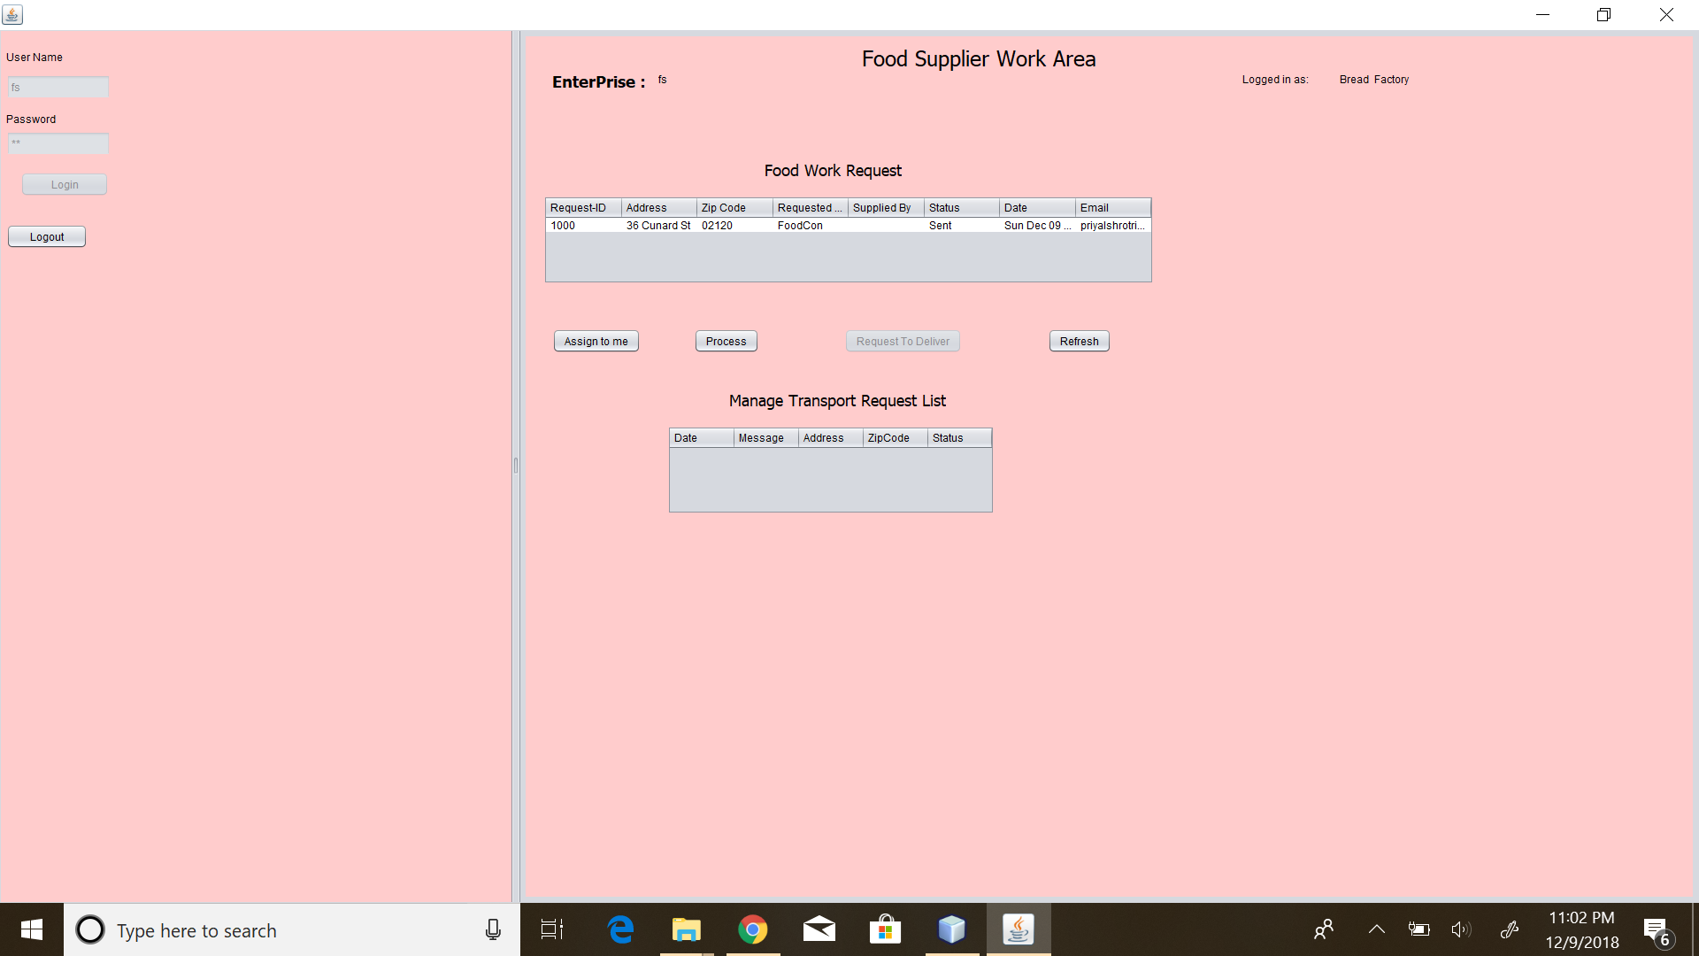

Slide 21
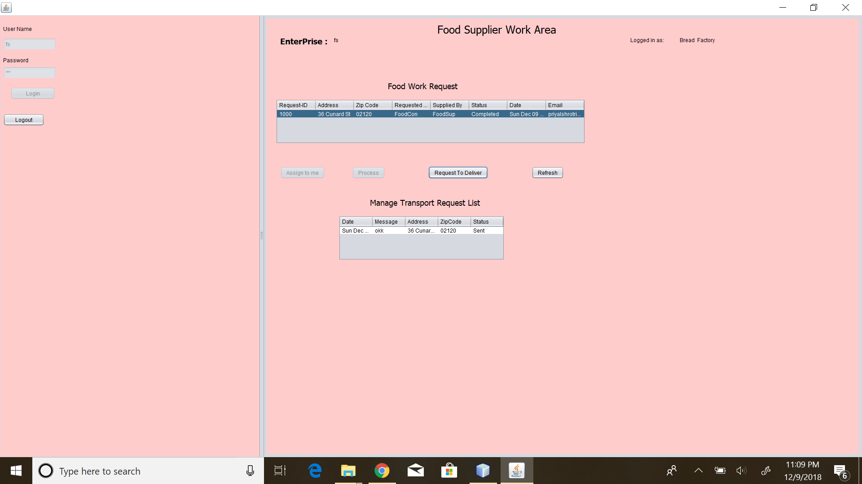

Slide 22


Slide 23
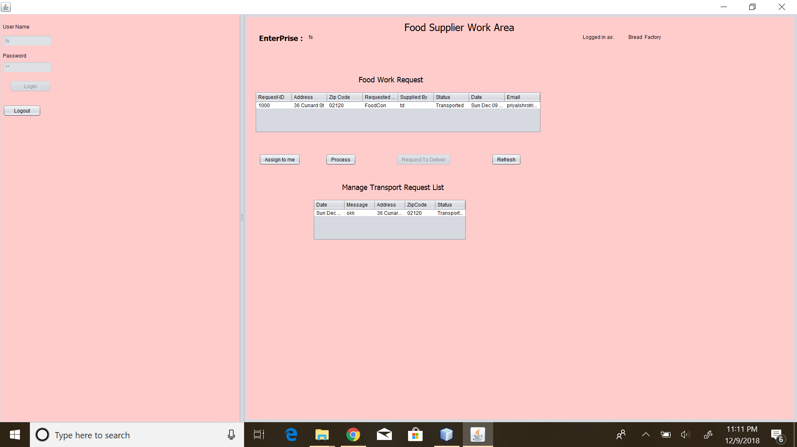

Slide 24
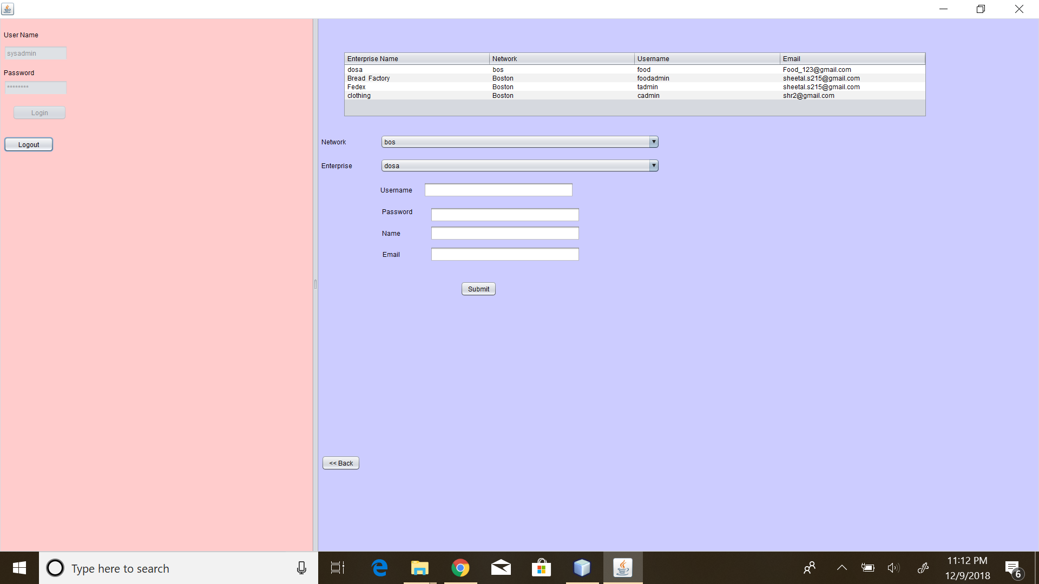

Slide 25
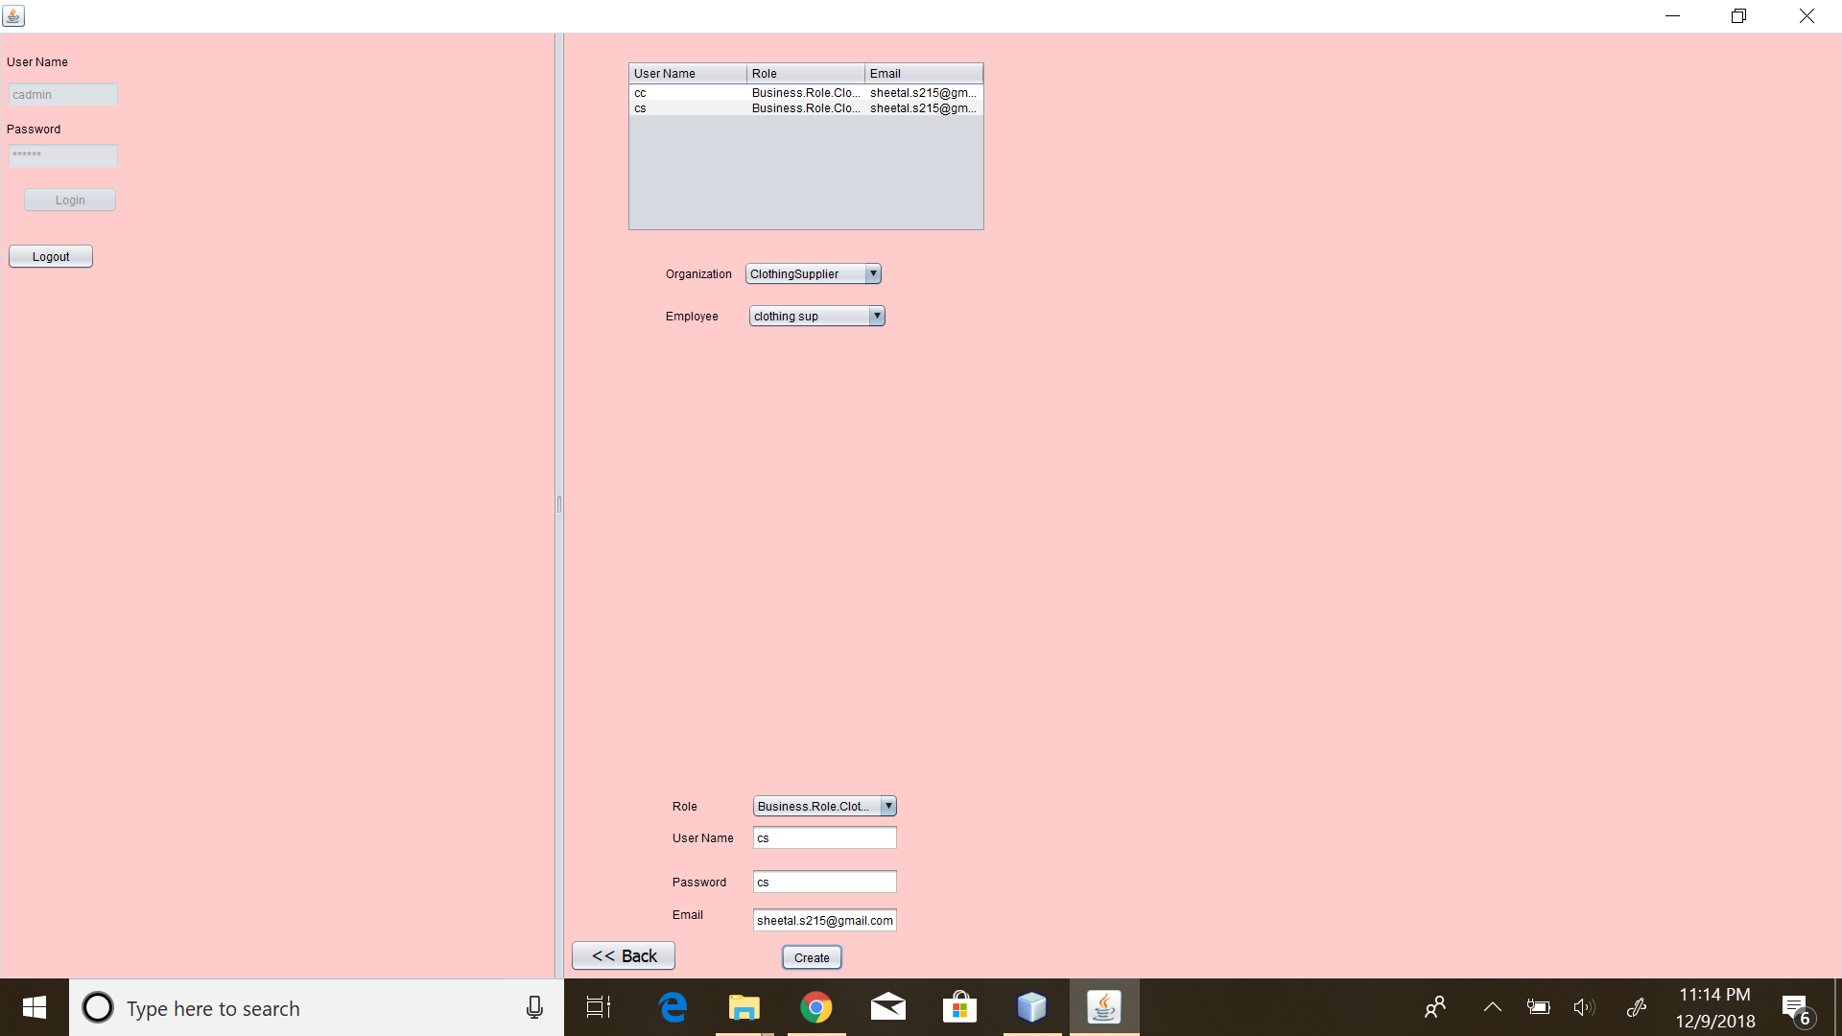

Slide 26
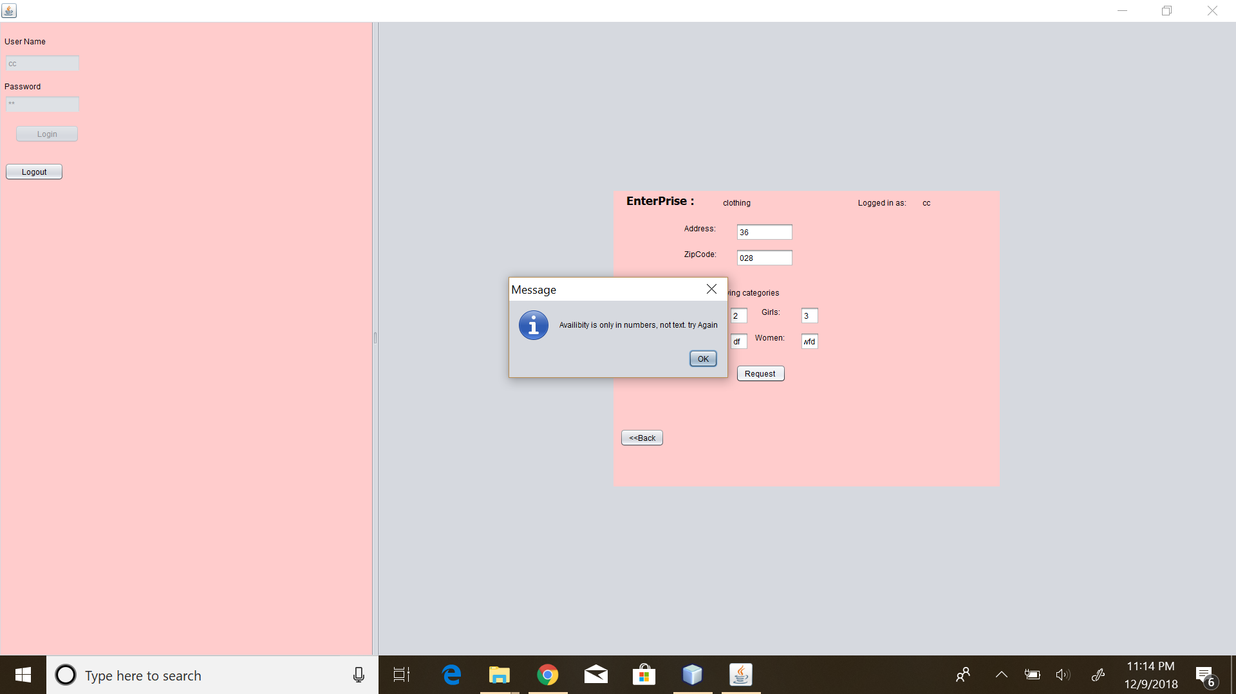

Slide 27


Slide 28
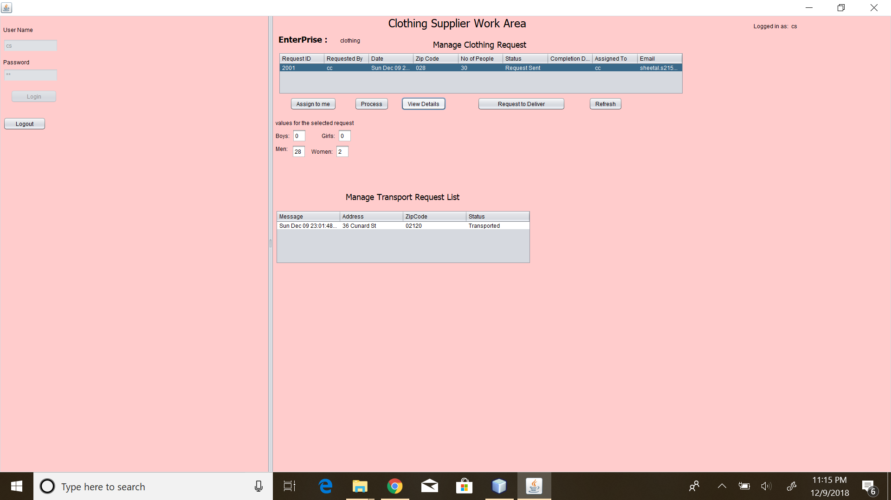

Slide 29
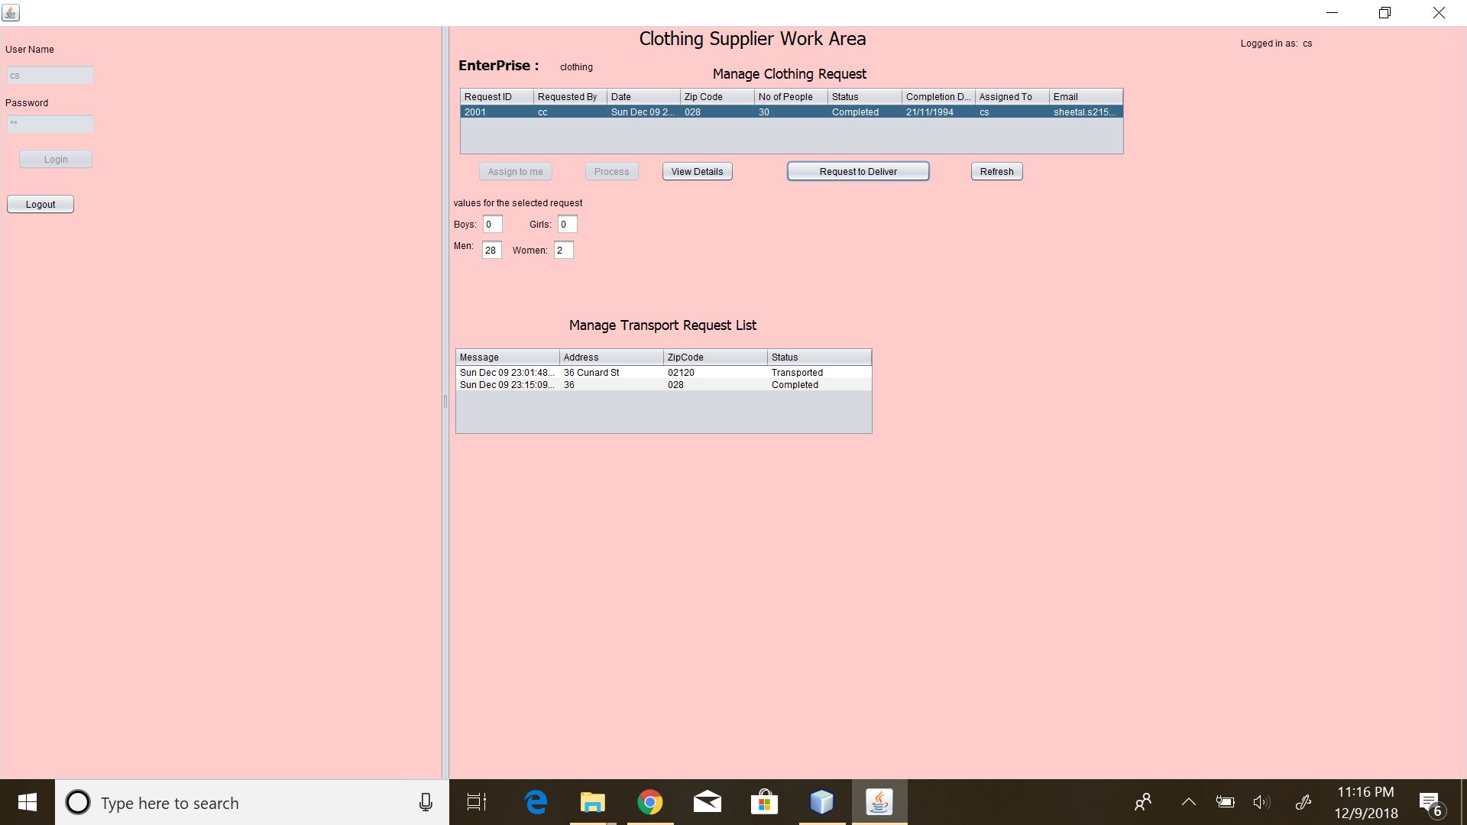

Slide 30
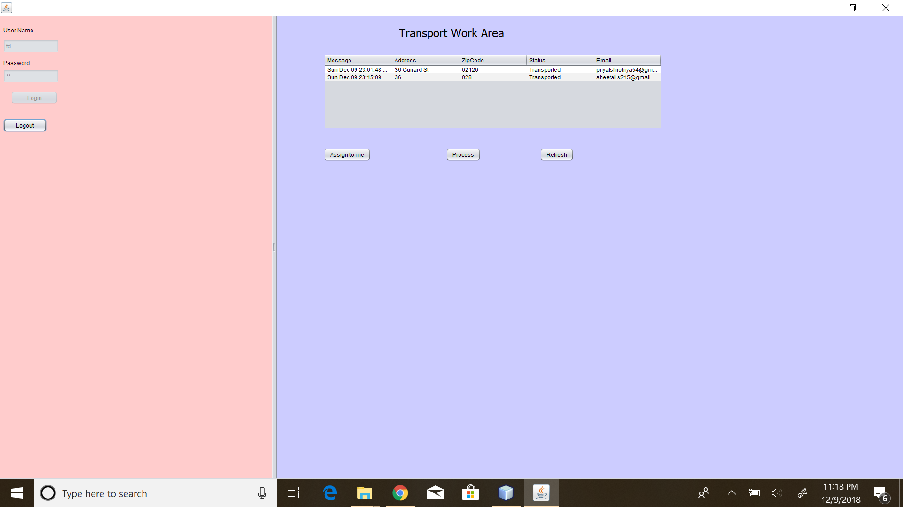

Slide 31
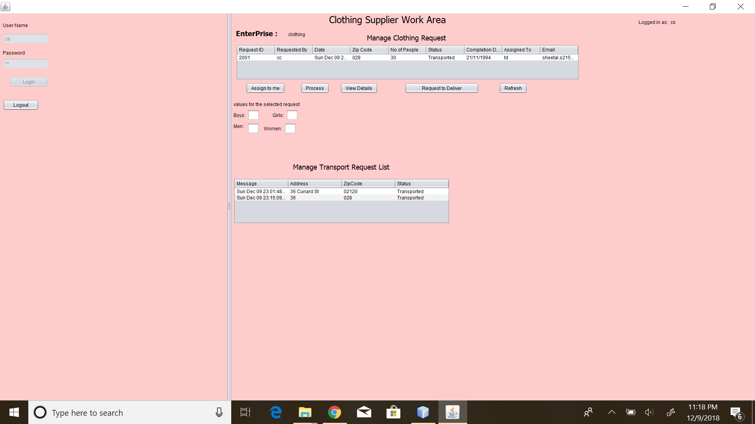

Slide 32
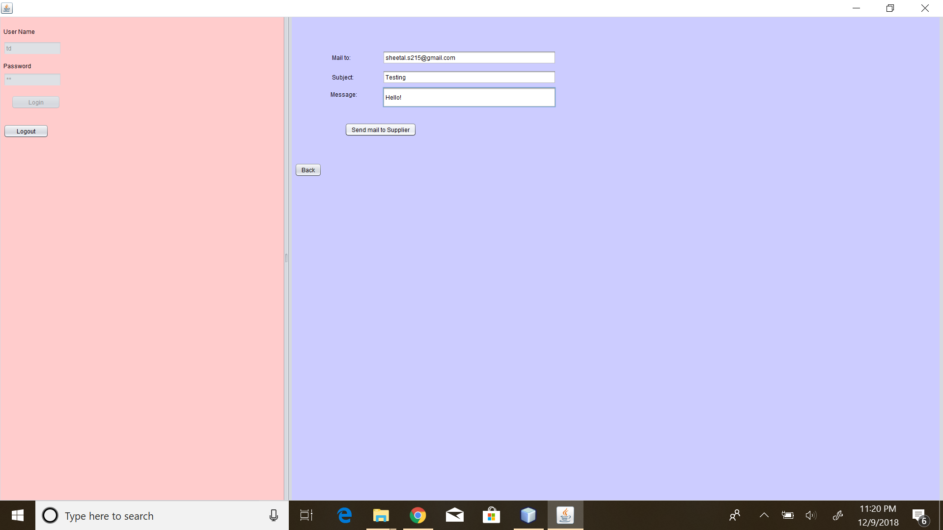

Slide 33
THANK YOU
Team Name: Chimera
-Sheetal Sekhar
-Priyal Shrotriya
-Praful Badami

